Slide 1
November 29, 2016
How Much of the Internet Is Fake? Turns Out, a Lot of It, Actually.
Subtitle or details about the presentation can go in this space.
Based on the article by Max Read
Presented by Udith Prabhu
For CS895 Fall 2020
Source - https://nymag.com/intelligencer/2018/12/how-much-of-the-internet-is-fake.html

Slide 2
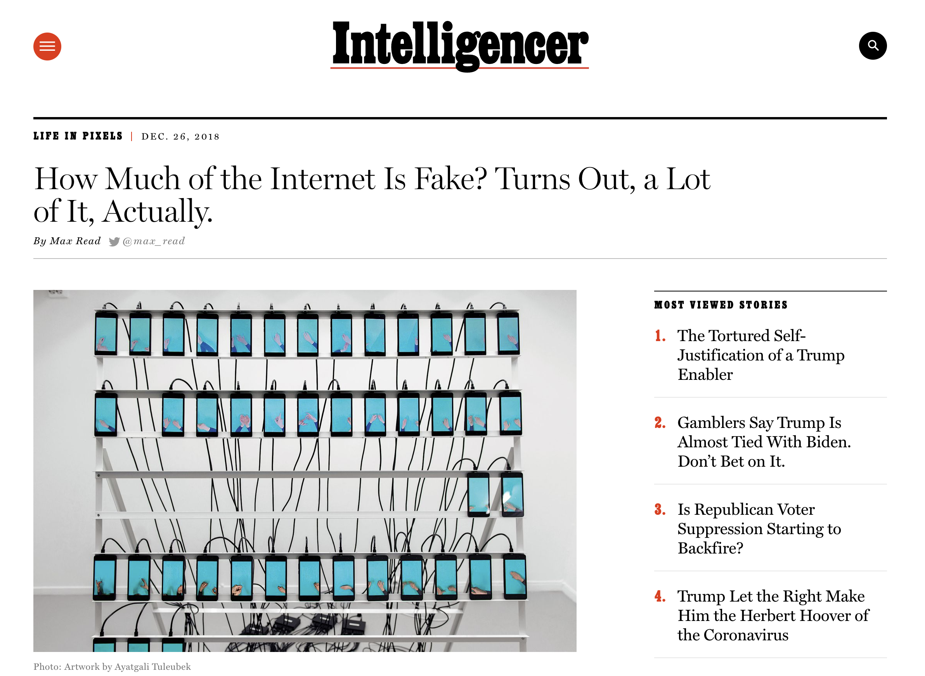
Article on which the presentation is based on
“How much of the Internet is Fake? Turns Out, a Lot of It, Actually.” Based on https://nymag.com/intelligencer/2018/12/how-much-of-the-internet-is-fake.html #cs895f20

Slide 3
Parts of the Internet that we will be focusing on
People
Metics
Content
Business
“How much of the Internet is Fake? Turns Out, a Lot of It, Actually.” Based on https://nymag.com/intelligencer/2018/12/how-much-of-the-internet-is-fake.html #cs895f20

Slide 4
Background
“How much of the Internet is Fake? Turns Out, a Lot of It, Actually.” Based on https://nymag.com/intelligencer/2018/12/how-much-of-the-internet-is-fake.html #cs895f20

Slide 5
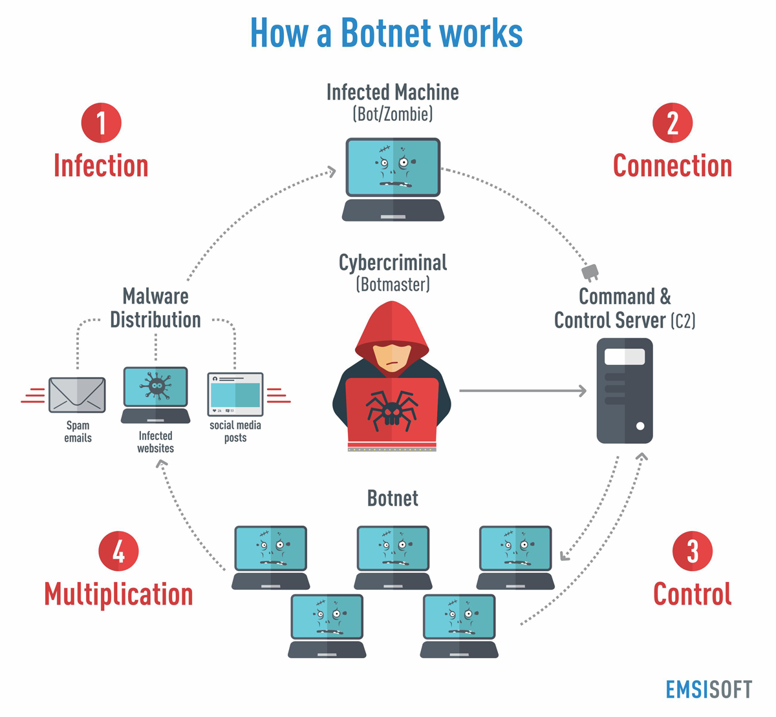
A Botnet is a network of infected devices
Botnets are a network of infected machines where each machine is running a malware.
Botnets are generally used to perform Distributed Denial of Service attack where all the bots in the botnet flood a victim website thereby disrupting its service.
https://blog.emsisoft.com/wp-content/uploads/2017/05/botnets_infographic-1.png
“How much of the Internet is Fake? Turns Out, a Lot of It, Actually.” Based on https://nymag.com/intelligencer/2018/12/how-much-of-the-internet-is-fake.html #cs895f20

Slide 6
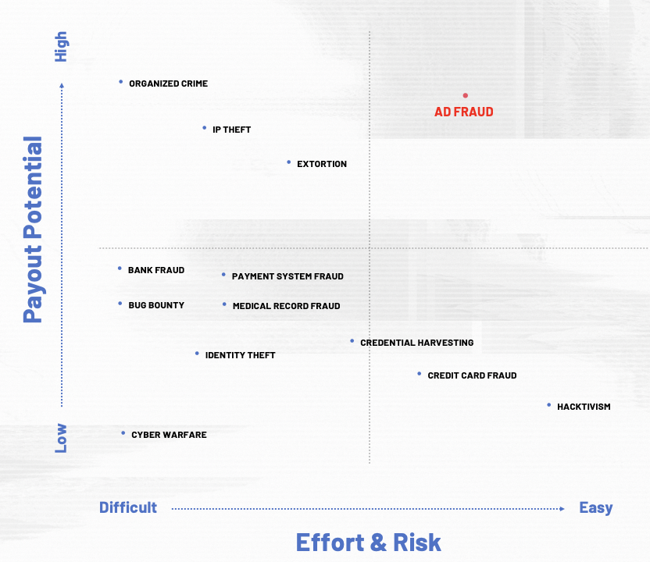
Ad Fraud is the most lucrative cybercrime with minimal risk
https://www.campaignasia.com/article/inside-ad-fraud-what-it-takes-to-dismantle-a-us5-8-billion-enterprise/455057
“How much of the Internet is Fake? Turns Out, a Lot of It, Actually.” Based on https://nymag.com/intelligencer/2018/12/how-much-of-the-internet-is-fake.html #cs895f20

Slide 7
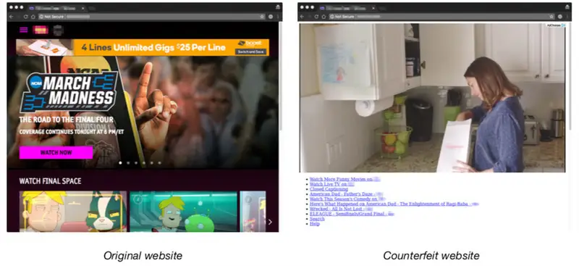
Counterfeit sites used in ad fraud
https://www.buzzfeednews.com/article/craigsilverman/3ve-botnet-ad-fraud-fbi-takedown
“How much of the Internet is Fake? Turns Out, a Lot of It, Actually.” Based on https://nymag.com/intelligencer/2018/12/how-much-of-the-internet-is-fake.html #cs895f20

Slide 8
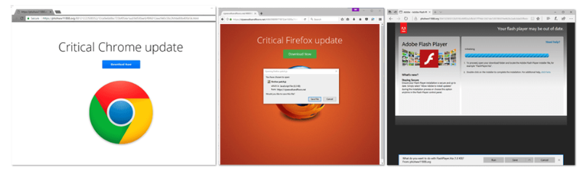
Malvertising
https://www.buzzfeednews.com/article/craigsilverman/3ve-botnet-ad-fraud-fbi-takedown
“How much of the Internet is Fake? Turns Out, a Lot of It, Actually.” Based on https://nymag.com/intelligencer/2018/12/how-much-of-the-internet-is-fake.html #cs895f20

Slide 9
Methbot and 3ve were the most successful ad fraud botnets
Methbot
Tracked by a cyber security firm - White Ops, in 2015
Consist of the following
500,000+ dedicated IPs
6000+ domains
250,000+ distinct URLs
3ve
3ve, pronounced as “Eve”, was a botnet that has been active from at least 2013.
Tracked by a cyber security firm - White Ops, in 2016.
The operation was halted in late 2018.
Consist of the following
1M+ dedicated IPs
10k+ domains
3 billion daily bid requests
“How much of the Internet is Fake? Turns Out, a Lot of It, Actually.” Based on https://nymag.com/intelligencer/2018/12/how-much-of-the-internet-is-fake.html #cs895f20

Slide 10
Methbot

Slide 11
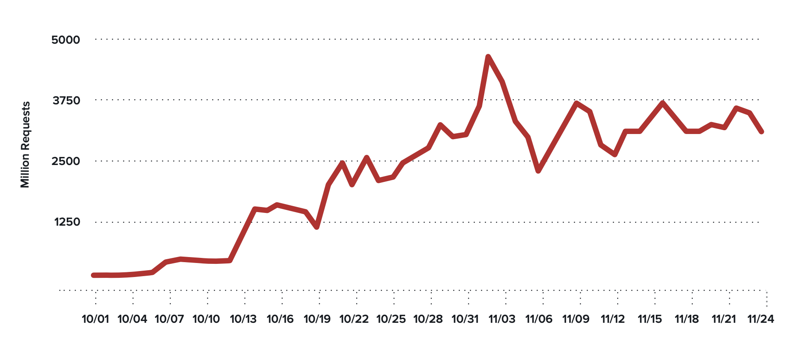
Methbot generated almost 5 billion bid requests
• $3 to $5 million in video advertising inventory per day
• Cost per mille ( CPM ) ranged from $3 to $36 with the average being around $13
• Targeted sites include Private Marketplaces
Impression Request Volume from Methbot
https://cdn2.hubspot.net/hubfs/3400937/WO_Methbot_Operation_WP_01.pdf
“How much of the Internet is Fake? Turns Out, a Lot of It, Actually.” Based on https://nymag.com/intelligencer/2018/12/how-much-of-the-internet-is-fake.html #cs895f20

Slide 12
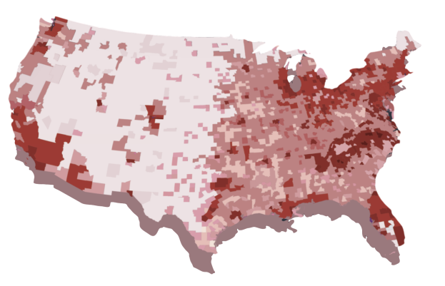
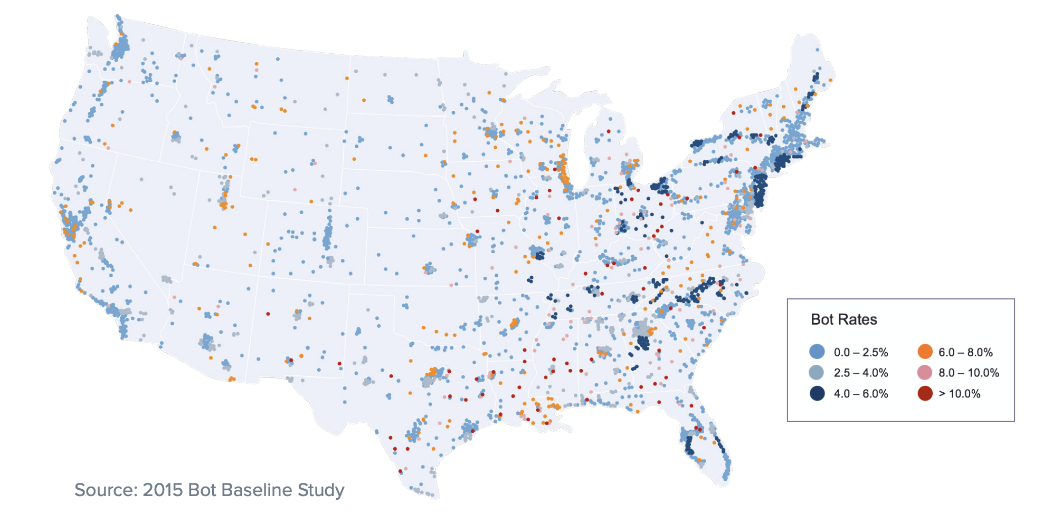
Traditional botnet vs Methbot in terms of scope
https://cdn2.hubspot.net/hubfs/3400937/WO_Methbot_Operation_WP_01.pdf
“How much of the Internet is Fake? Turns Out, a Lot of It, Actually.” Based on https://nymag.com/intelligencer/2018/12/how-much-of-the-internet-is-fake.html #cs895f20

Slide 13
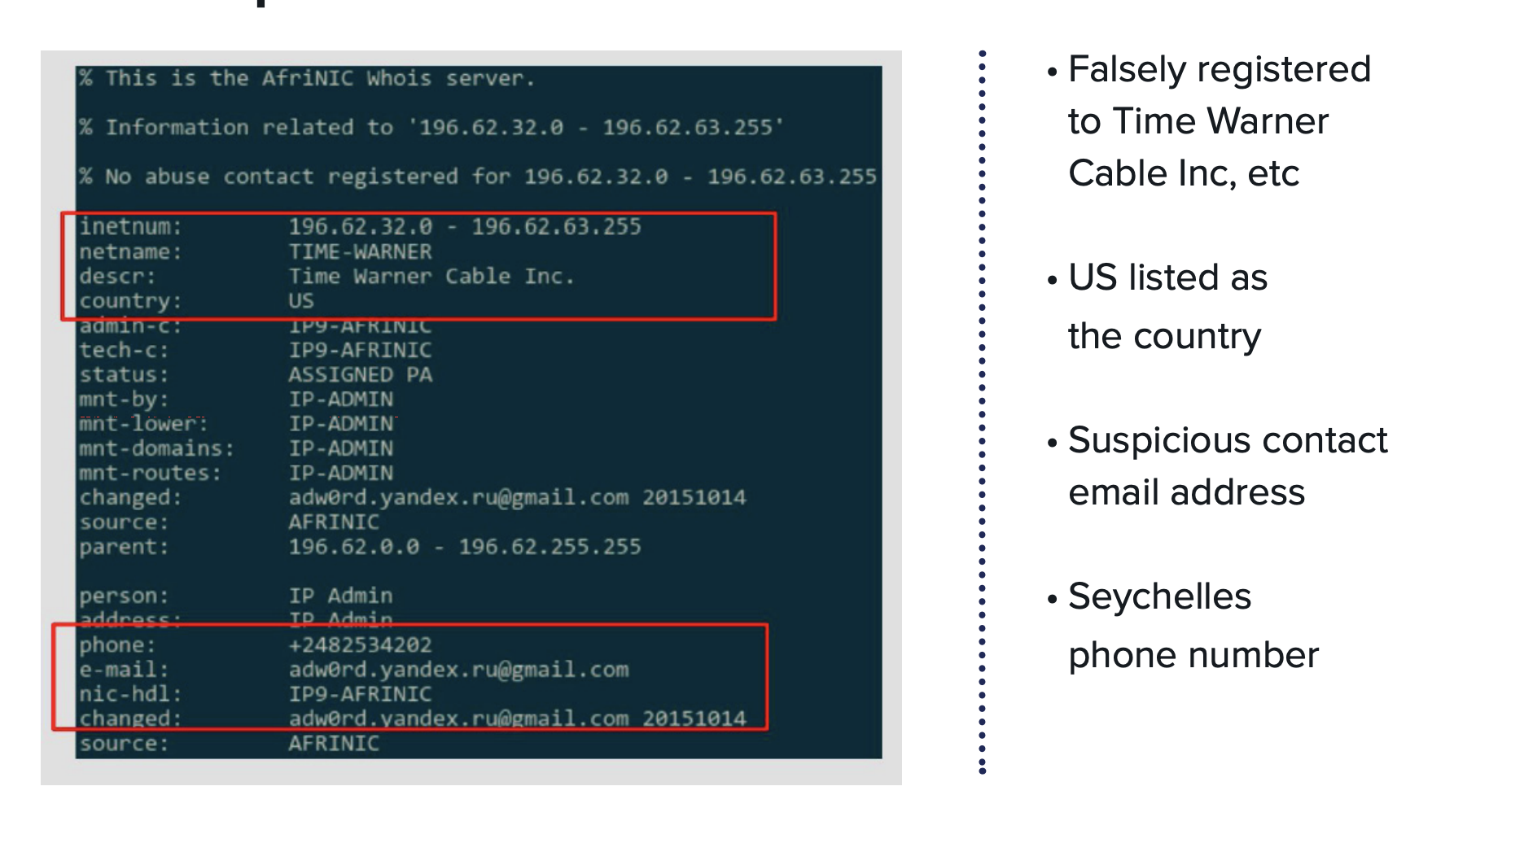
Suspicious WHOIS information
“How much of the Internet is Fake? Turns Out, a Lot of It, Actually.” Based on https://nymag.com/intelligencer/2018/12/how-much-of-the-internet-is-fake.html #cs895f20

Slide 14
3ve
“How much of the Internet is Fake? Turns Out, a Lot of It, Actually.” Based on https://nymag.com/intelligencer/2018/12/how-much-of-the-internet-is-fake.html #cs895f20

Slide 15
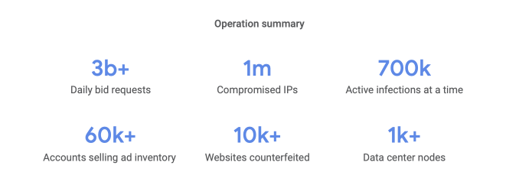
Scope of 3ve
https://services.google.com/fh/files/blogs/3ve_google_whiteops_whitepaper_final_nov_2018.pdf
“How much of the Internet is Fake? Turns Out, a Lot of It, Actually.” Based on https://nymag.com/intelligencer/2018/12/how-much-of-the-internet-is-fake.html #cs895f20

Slide 16
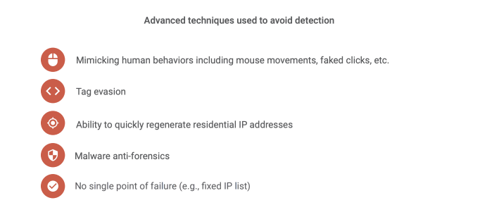
3ve mimicked human behaviour to avoid detection
https://services.google.com/fh/files/blogs/3ve_google_whiteops_whitepaper_final_nov_2018.pdf
“How much of the Internet is Fake? Turns Out, a Lot of It, Actually.” Based on https://nymag.com/intelligencer/2018/12/how-much-of-the-internet-is-fake.html #cs895f20

Slide 17
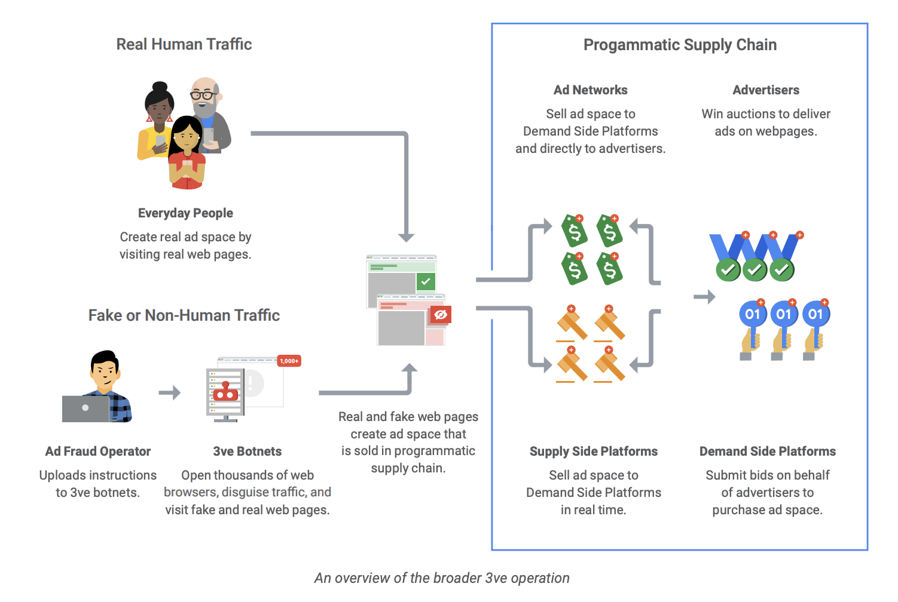
Operational details of 3ve
https://services.google.com/fh/files/blogs/3ve_google_whiteops_whitepaper_final_nov_2018.pdf
“How much of the Internet is Fake? Turns Out, a Lot of It, Actually.” Based on https://nymag.com/intelligencer/2018/12/how-much-of-the-internet-is-fake.html #cs895f20

Slide 18
What does this mean for the us?
“How much of the Internet is Fake? Turns Out, a Lot of It, Actually.” Based on https://nymag.com/intelligencer/2018/12/how-much-of-the-internet-is-fake.html #cs895f20

Slide 19
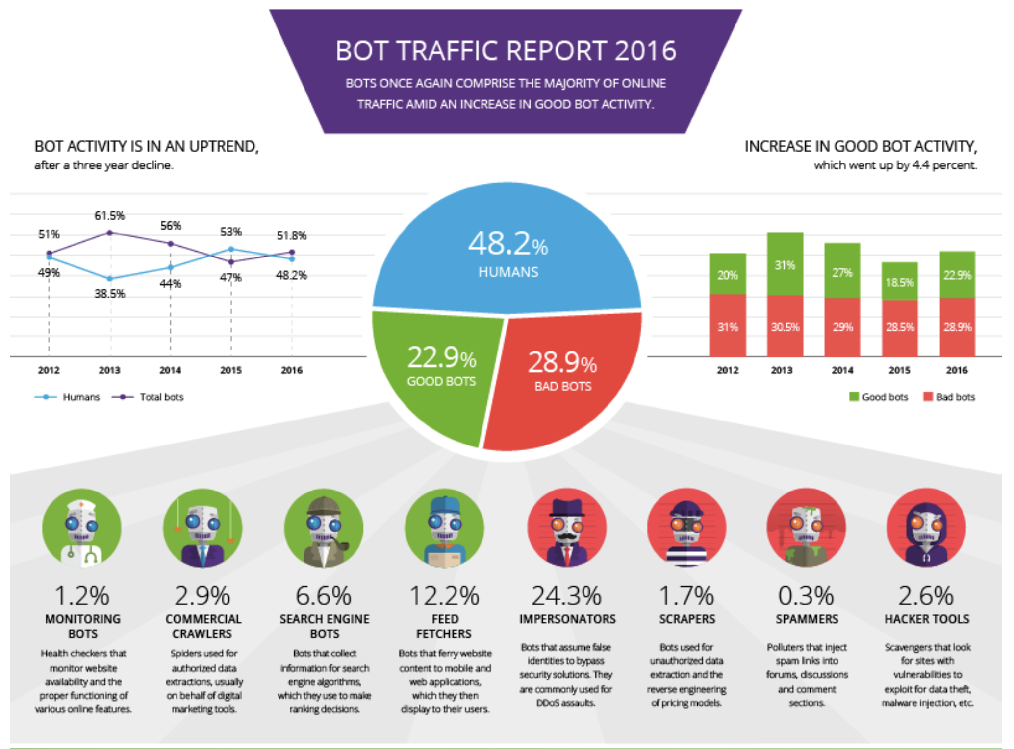
Bot vs Human traffic
https://www.imperva.com/blog/bot-traffic-report-2016/
“How much of the Internet is Fake? Turns Out, a Lot of It, Actually.” Based on https://nymag.com/intelligencer/2018/12/how-much-of-the-internet-is-fake.html #cs895f20

Slide 20
The Inversion
51.8% bot traffic vs 48.2% human traffic
New York Times reported that at one point in 2013 that Youtube had more bot visitors than human ones.
Youtube employees feared that the website’s anti-fraud system will start marking bot traffic as valid and human traffic as fraudulent.
Post-Inversion, real human users will be considered outliers.
Source - https://www.nytimes.com/interactive/2018/08/11/technology/youtube-fake-view-sellers.html
“How much of the Internet is Fake? Turns Out, a Lot of It, Actually.” Based on https://nymag.com/intelligencer/2018/12/how-much-of-the-internet-is-fake.html #cs895f20

Slide 21
5 metrics that drive the advertising industry
Metrics are countable, trackable, and verifiable.
Our biggest social and search platforms are supported by metrics.
List of metrics
Engaged-views
Views
Avg. Cost per view
Watch time
Avg. watch time
“How much of the Internet is Fake? Turns Out, a Lot of It, Actually.” Based on https://nymag.com/intelligencer/2018/12/how-much-of-the-internet-is-fake.html #cs895f20

Slide 22
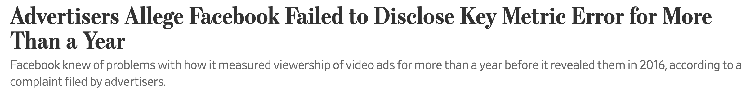
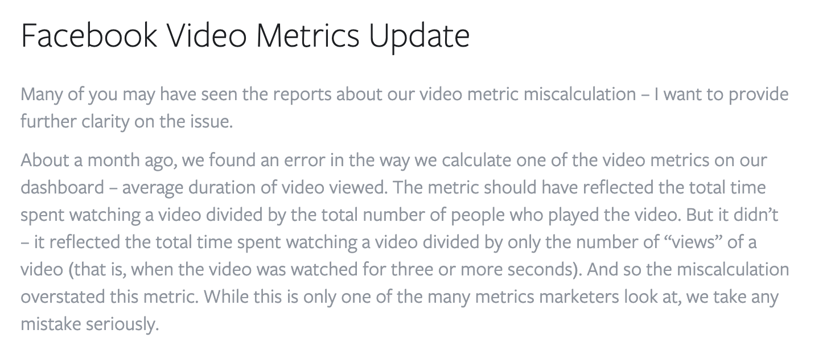
The Metrics are fake
https://www.wsj.com/articles/advertisers-allege-facebook-failed-to-disclose-key-metric-error-for-more-than-a-year-1539720524?mod=mhp
https://www.facebook.com/business/news/facebook-video-metrics-update
“How much of the Internet is Fake? Turns Out, a Lot of It, Actually.” Based on https://nymag.com/intelligencer/2018/12/how-much-of-the-internet-is-fake.html #cs895f20

Slide 23
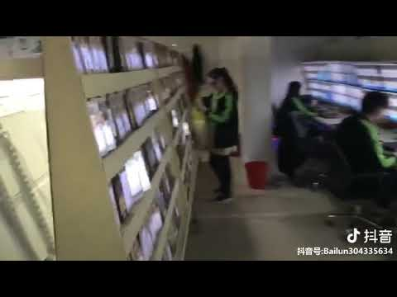
The people are fake - Chinese Click Farm
5000 Youtube views can be bought for with $15
These views are brought about by bots
At least 70% of videos watched is from the recommendation algorithm of Youtube.
The recommendation algorithm works on a virtuous cycle where more views equal higher ranking.
Source: https://blog.hootsuite.com/youtube-stats-marketers/
https://youtu.be/X_pRsSM_sXQ
“How much of the Internet is Fake? Turns Out, a Lot of It, Actually.” Based on https://nymag.com/intelligencer/2018/12/how-much-of-the-internet-is-fake.html #cs895f20

Slide 24
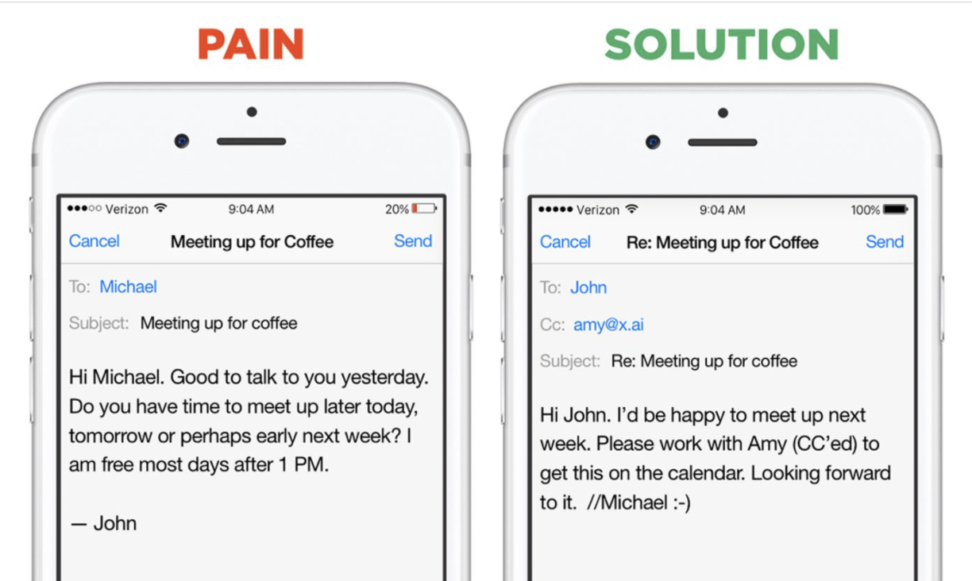
Smart Assistants
https://assets.bwbx.io/images/users/iqjWHBFdfxIU/i7uN23YtExp0/v1/-1x-1.jpg
“How much of the Internet is Fake? Turns Out, a Lot of It, Actually.” Based on https://nymag.com/intelligencer/2018/12/how-much-of-the-internet-is-fake.html #cs895f20

Slide 25
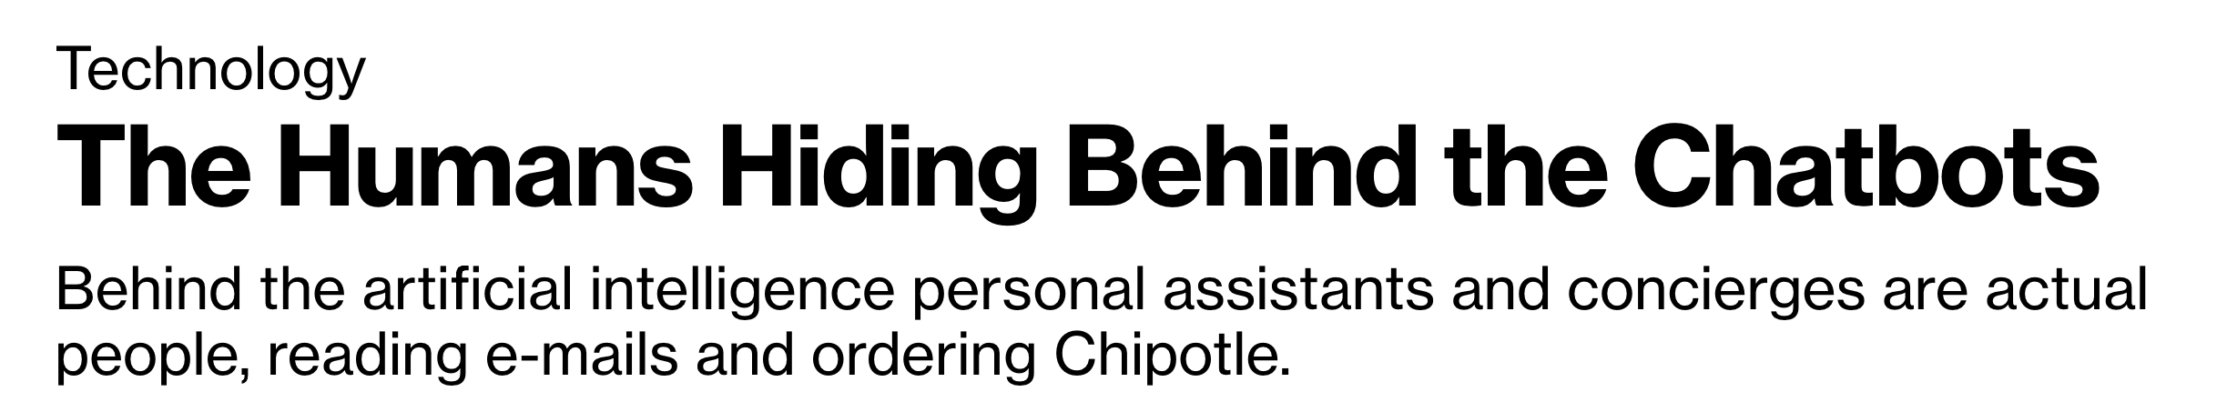
The bots are fake - Hyper intelligent smart assistants
https://www.bloomberg.com/news/articles/2016-04-18/the-humans-hiding-behind-the-chatbots
Amy Ingram from X.ai and M from Facebook were found to be highly regulated by humans which made the assistants demonstrate hyper smart artificial intelligence.
“How much of the Internet is Fake? Turns Out, a Lot of It, Actually.” Based on https://nymag.com/intelligencer/2018/12/how-much-of-the-internet-is-fake.html #cs895f20

Slide 26
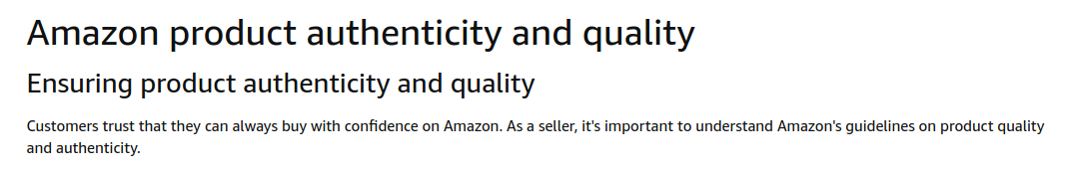
Authenticity of Businesses - Amazon Seller
https://sellercentral.amazon.com/gp/help/external/G202010130?language=en_US
https://sellercentral.amazon.com/gp/help/external/201165970
“How much of the Internet is Fake? Turns Out, a Lot of It, Actually.” Based on https://nymag.com/intelligencer/2018/12/how-much-of-the-internet-is-fake.html #cs895f20

Slide 27
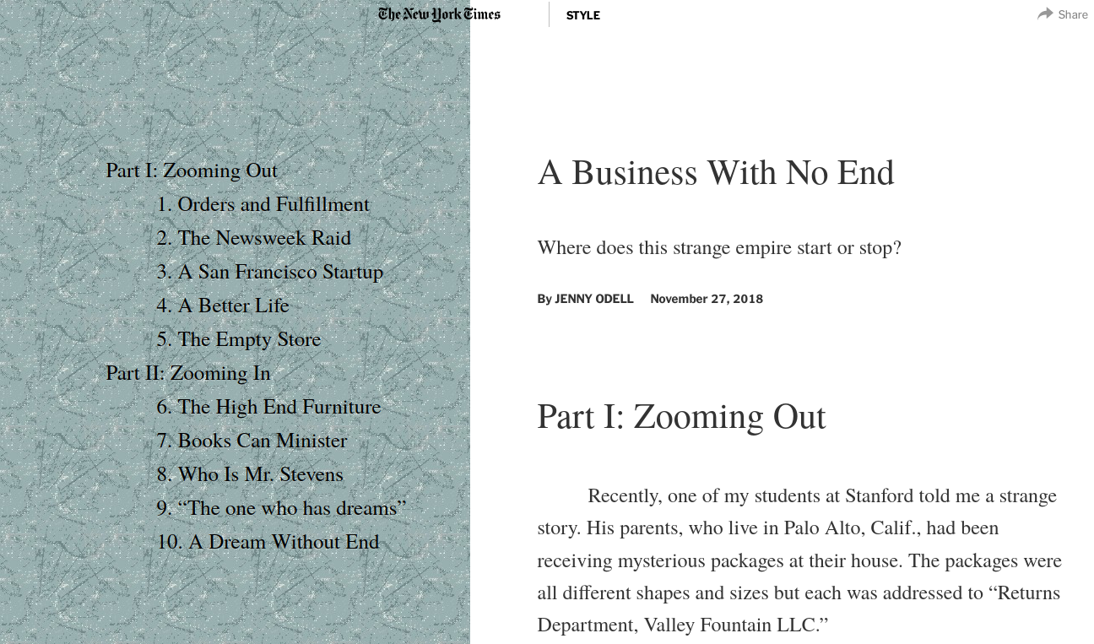

The businesses are fake
141 LLCs registered in the same address
https://www.nytimes.com/interactive/2018/11/27/style/what-is-inside-this-internet-rabbit-hole.html
“How much of the Internet is Fake? Turns Out, a Lot of It, Actually.” Based on https://nymag.com/intelligencer/2018/12/how-much-of-the-internet-is-fake.html #cs895f20

Slide 28

Selling products at inflated prices on Amazon
https://www.nytimes.com/interactive/2018/11/27/style/what-is-inside-this-internet-rabbit-hole.html
“How much of the Internet is Fake? Turns Out, a Lot of It, Actually.” Based on https://nymag.com/intelligencer/2018/12/how-much-of-the-internet-is-fake.html #cs895f20

Slide 29
Fake reseller’s business methodology
Buy Wholesale
List on Amazon
Cash In
Buy the products at a cheap price wholesale in or outside Amazon
List the products on Amazon with inflated prices using multiple fake businesses
Wait for an unsuspecting customer to buy the product even though the same product with a different name will be available at a considerably cheaper price
“How much of the Internet is Fake? Turns Out, a Lot of It, Actually.” Based on https://nymag.com/intelligencer/2018/12/how-much-of-the-internet-is-fake.html #cs895f20

Slide 30
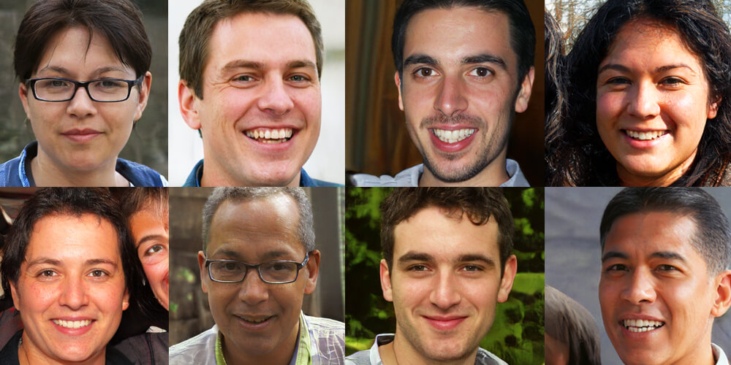
Content is fake - Image
None of these people actually exist
Generated using DeepFakes technology
https://careerswithstem.com.au/deep-fakes-this-person-does-not-exist/
“How much of the Internet is Fake? Turns Out, a Lot of It, Actually.” Based on https://nymag.com/intelligencer/2018/12/how-much-of-the-internet-is-fake.html #cs895f20

Slide 31

Content is fake - Video
Many content providers are generating massive amounts of low quality videos that feature famous and iconic characters.
This entices small children into viewing the video which increases the view count.
Source: https://nymag.com/intelligencer/2018/08/what-is-the-baby-meme-about-eating-sugar-and-telling-lies.html
“How much of the Internet is Fake? Turns Out, a Lot of It, Actually.” Based on https://nymag.com/intelligencer/2018/12/how-much-of-the-internet-is-fake.html #cs895f20

Slide 32
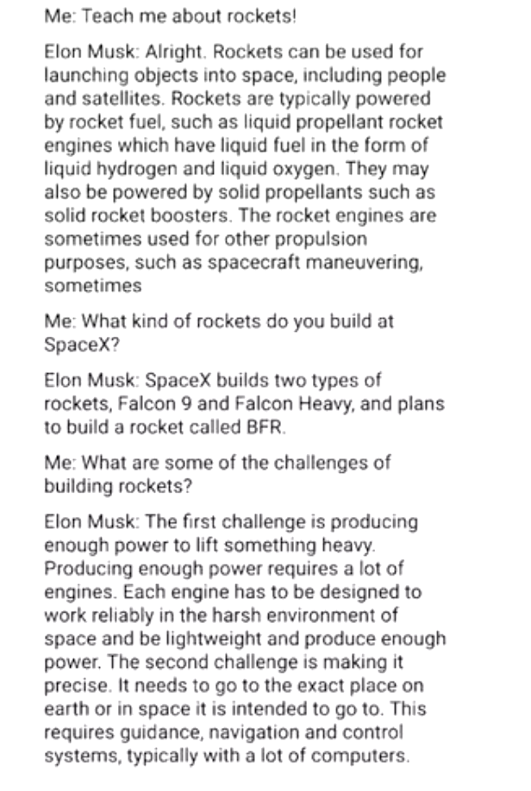
Content is fake - Text
A Deep learning network called GPT3 was used to generate the dialogues annotated with “Elon Musk”
The network is so powerful that it can generate entire react apps based on user’s description.
https://twitter.com/mckaywrigley/status/1284110063498522624
“How much of the Internet is Fake? Turns Out, a Lot of It, Actually.” Based on https://nymag.com/intelligencer/2018/12/how-much-of-the-internet-is-fake.html #cs895f20

Slide 33
Key Takeaways
Metrics-driven growth and unregulated platform marketplaces has created an Internet ecosystem where it more comfortable to lie, cheat or fake rather than to be real.
If this is not rectified, the Internet will be reduced to a network of bots with fake content, fake people, fake businesses, and fake metrics.
“How much of the Internet is Fake? Turns Out, a Lot of It, Actually.” Based on https://nymag.com/intelligencer/2018/12/how-much-of-the-internet-is-fake.html #cs895f20

